Slide 1
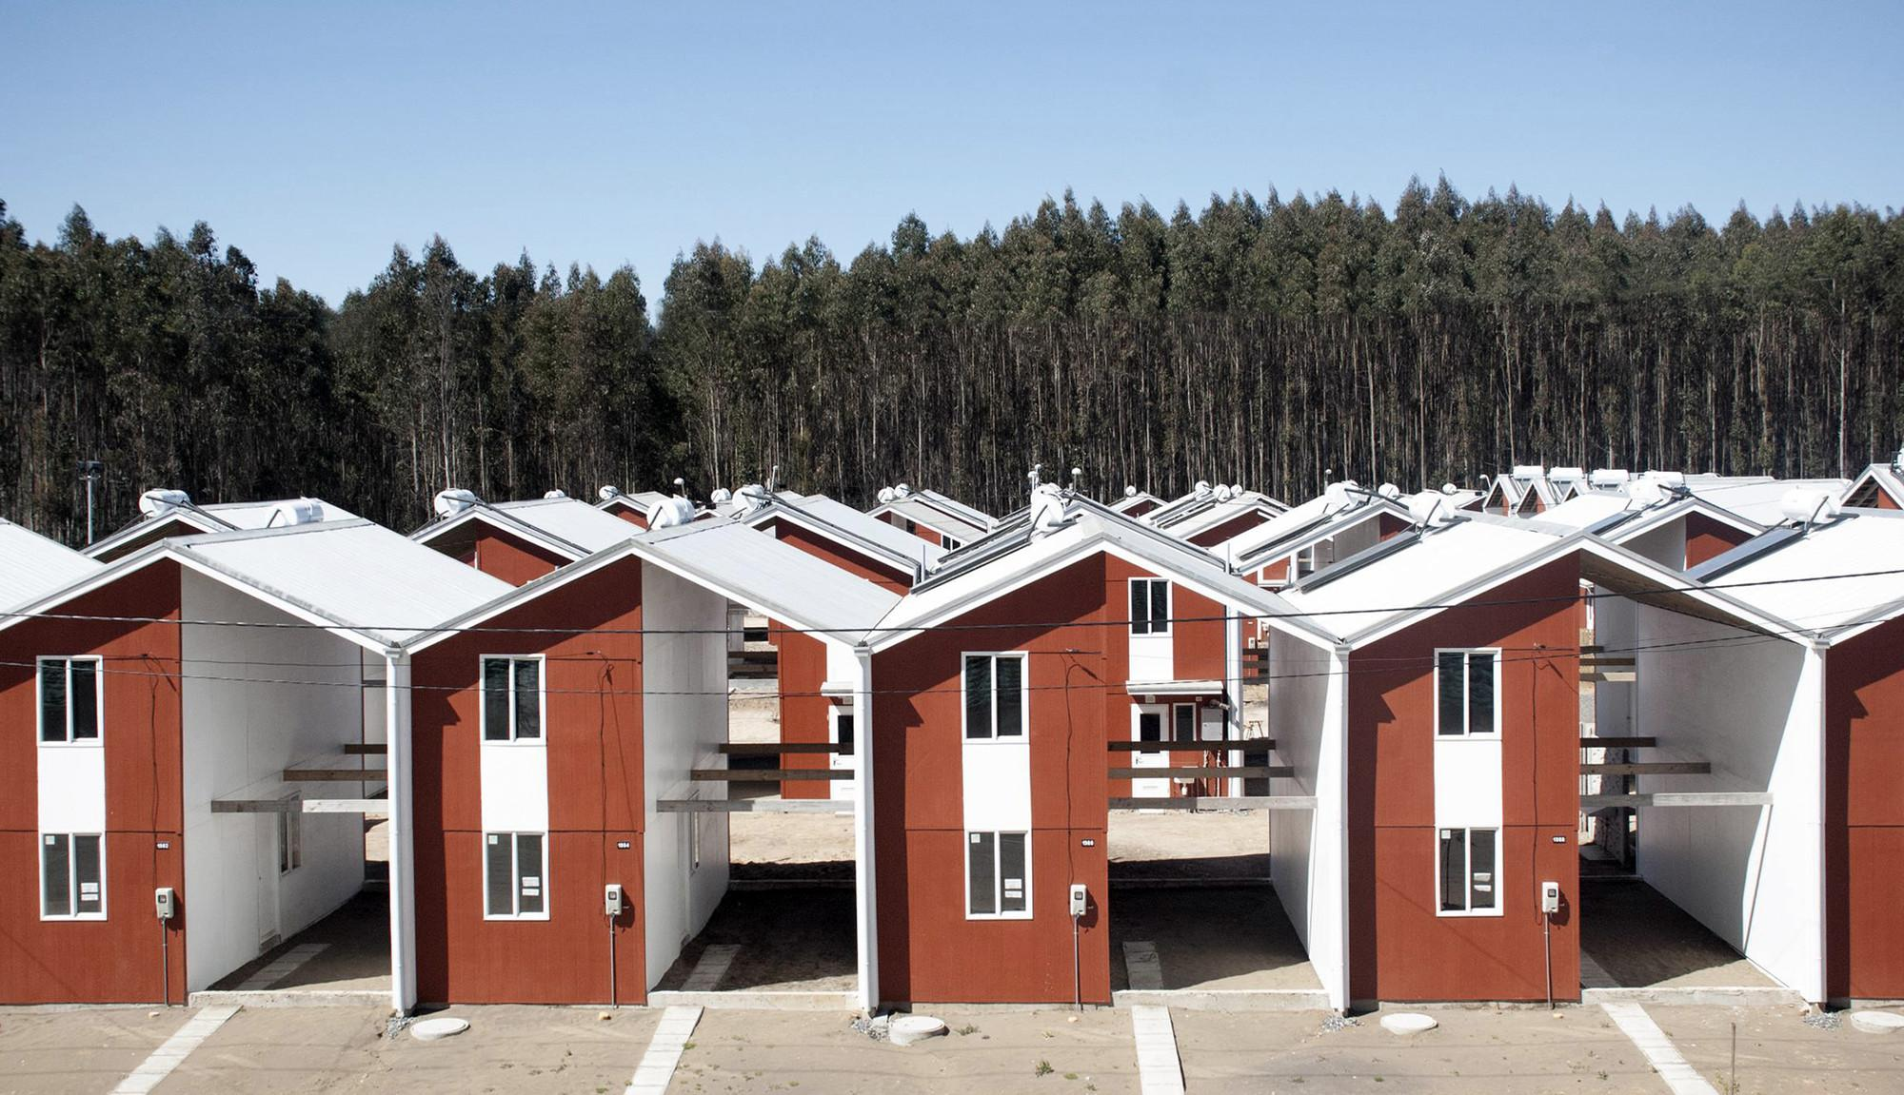
Portfolio Part 1
Villa Verde Community House - designed by Alejandro Aravena
Jarrad Meilak

Slide 2
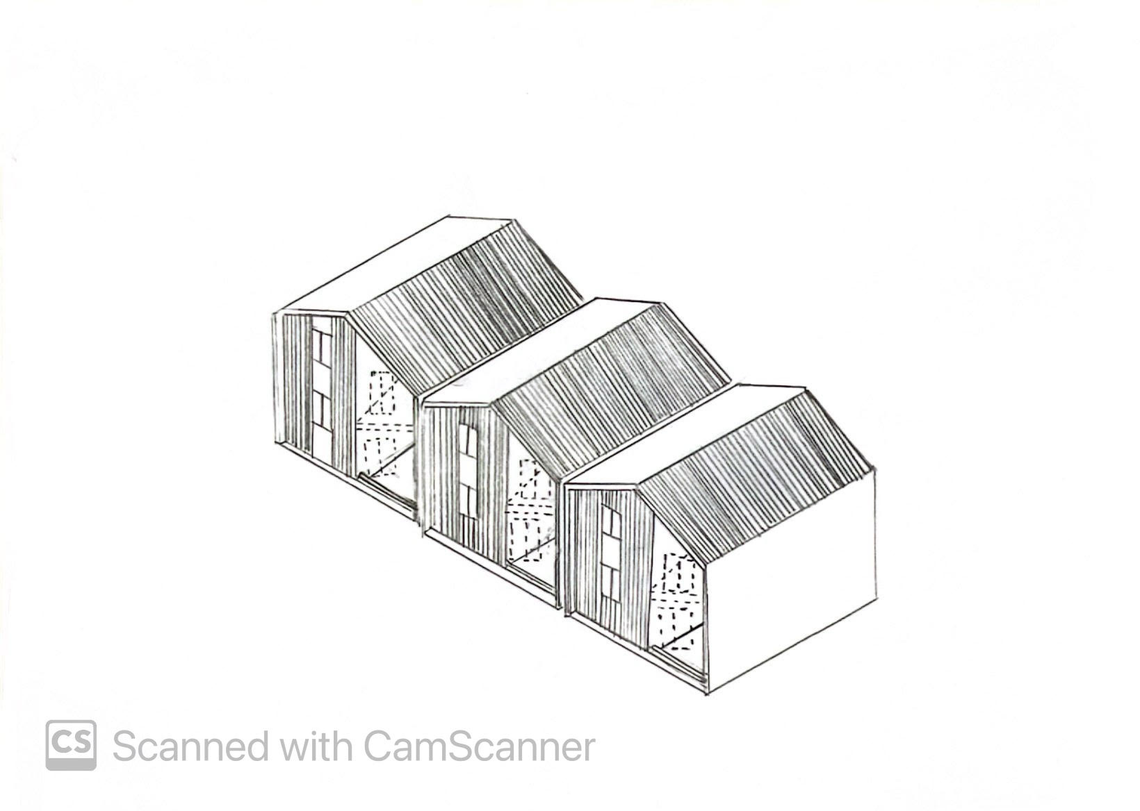
Perspective sketch

Slide 3
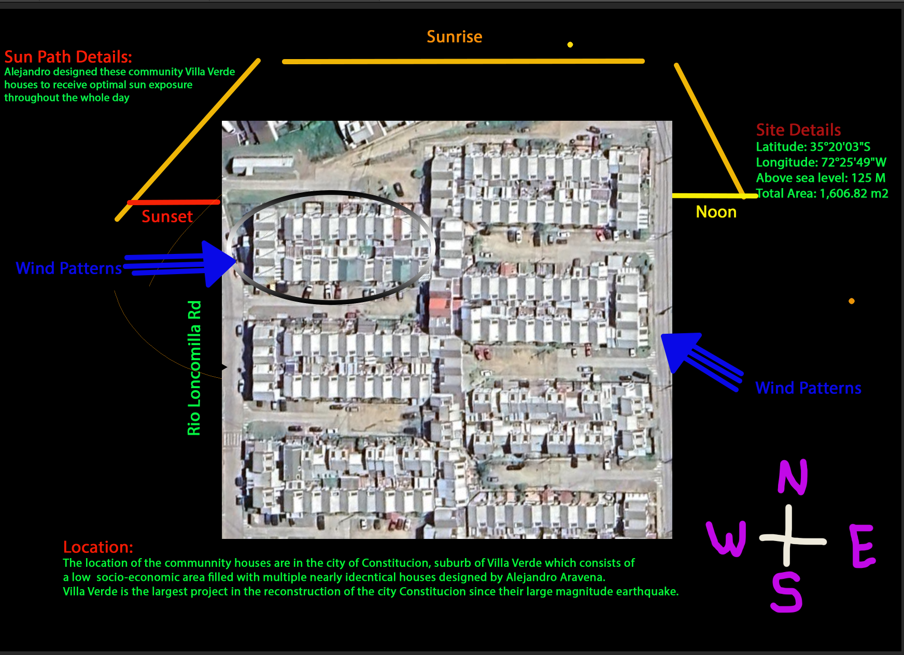
Site Analysis

Slide 4
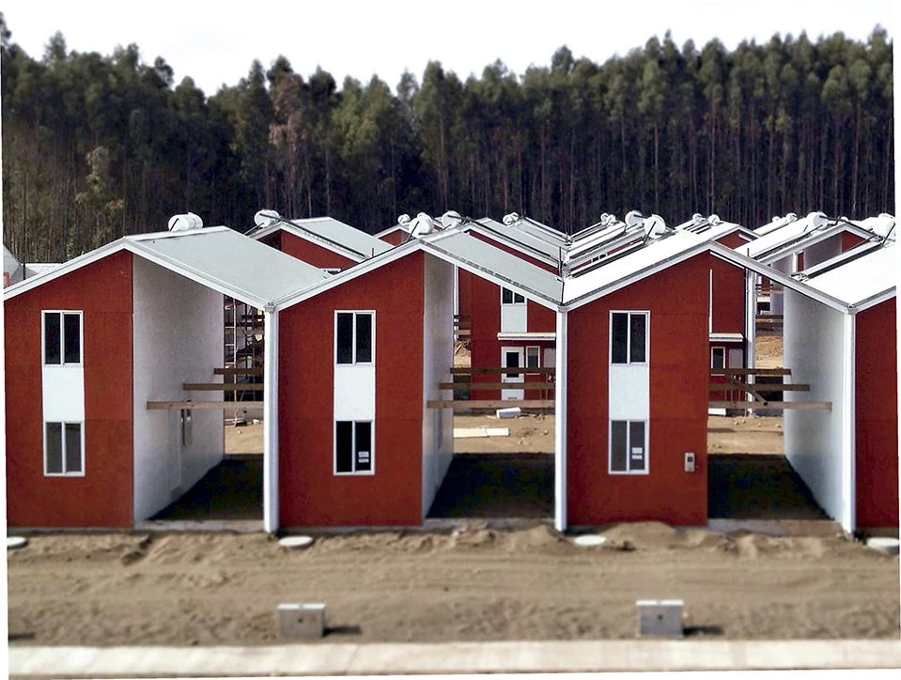
Notes/Plan for Model
Materials:
Radiata laser Plywood x 15 pieces of 30cm x 30cm plywood
1x hot glue gun $13.60
3x Hinges $3.00
2x Spray paint, Orange and white $10
1 x Sale ruler
1x T-square
Cost estimation:
Around $40
Measurements:
Each house 30cm x 3 - scale 1:20
Plan/Steps:
Create to do list for project
Gather materials for project
Measure each house and dimensions on base for houses
Cut house panels to correct size
Glue panels together
Glue whole panels to base
Add minor details

Slide 5
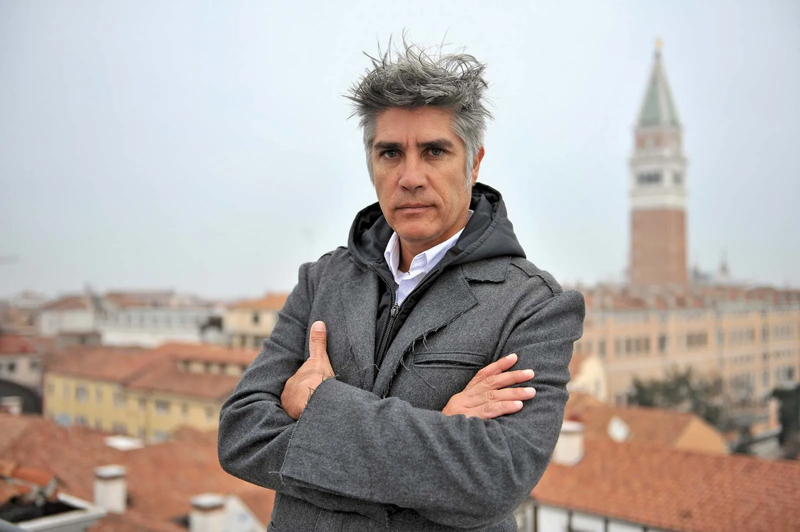
Group Theme - Cost efficiency
Our group 3, Karam, Nathan and myself have chosen the theme of cost efficiency within our selected case studies, as it is an important consideration for our architects to recognise whilst designing their buildings/houses. My chosen architect Alejandro Aravena utilises a wide variety of cost efficiency tactics during the design process of the Villa Verde community houses. His main objective during the design process of the community houses was to support the lower economic class of Chile as they would not be able to afford a large good house, so he’s idea was, why not give them half a good house. Constitucion was impacted to a great degree during 2012 when they sustained a large 7.1 magnitude earthquake which wiped out majority of the houses. During the rebuild the government could not afford to rebuild many small houses so they reached out to Alejandro who came up with the great innovative idea of building many half good houses. It was a cheaper and better option during the rebuild process. I chose this case study as I felt it was very interesting and wanted to learn more about this great project of Alejandro’s so I thought it would be good to explore further. Alejandro Aravena felt the need to be the person who would help revive his city of Constitucion, Chile after their mass destruction earthquake which destroyed the peoples houses and buildings. He was the person who bought the city back to life.

Slide 6
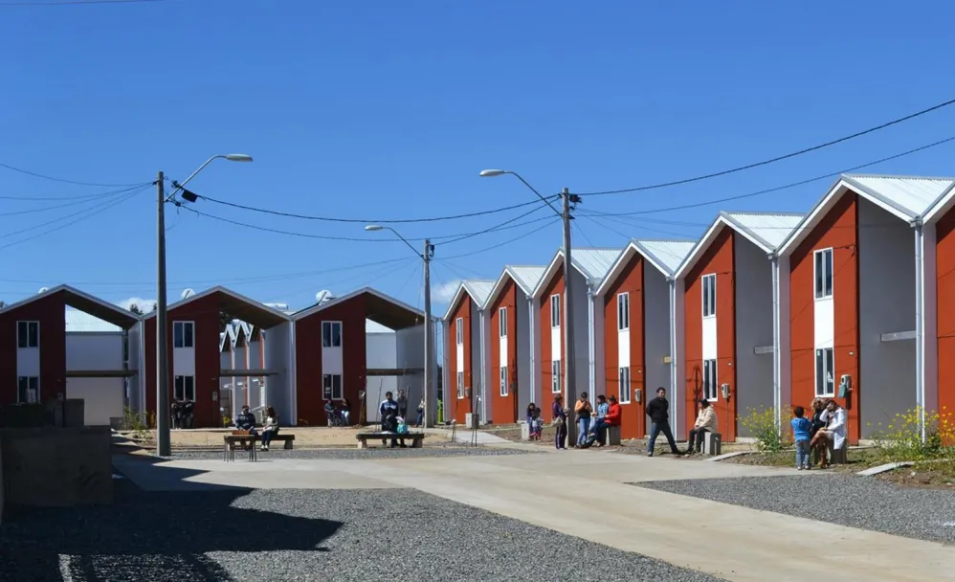
Part 2

Slide 7
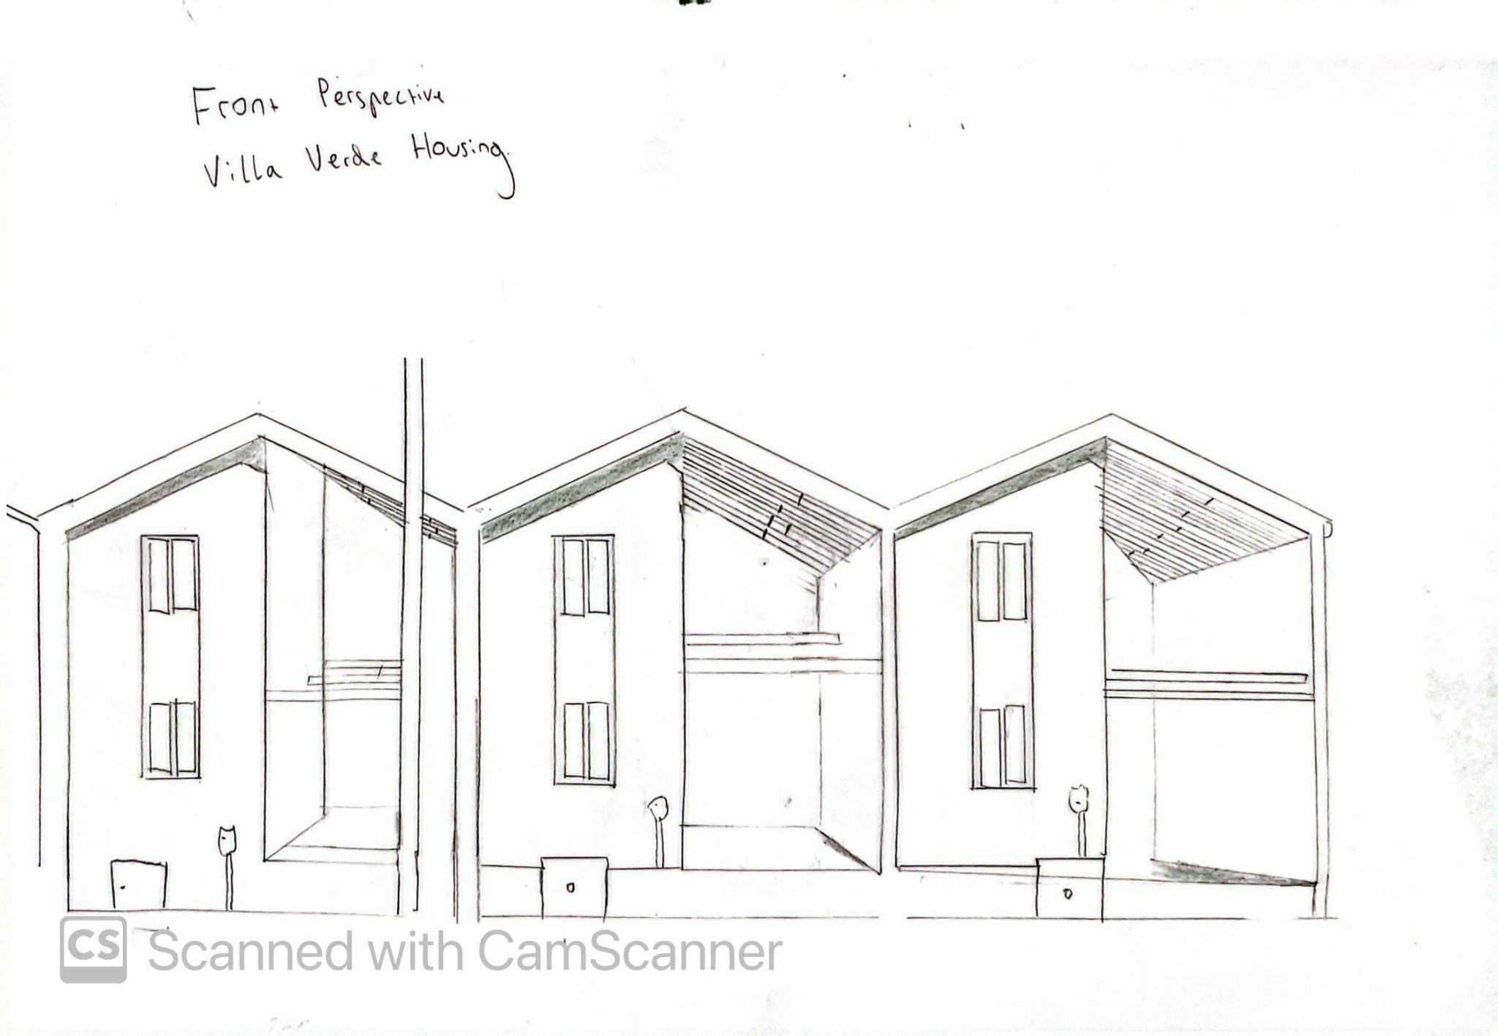
Perspective sketch

Slide 8
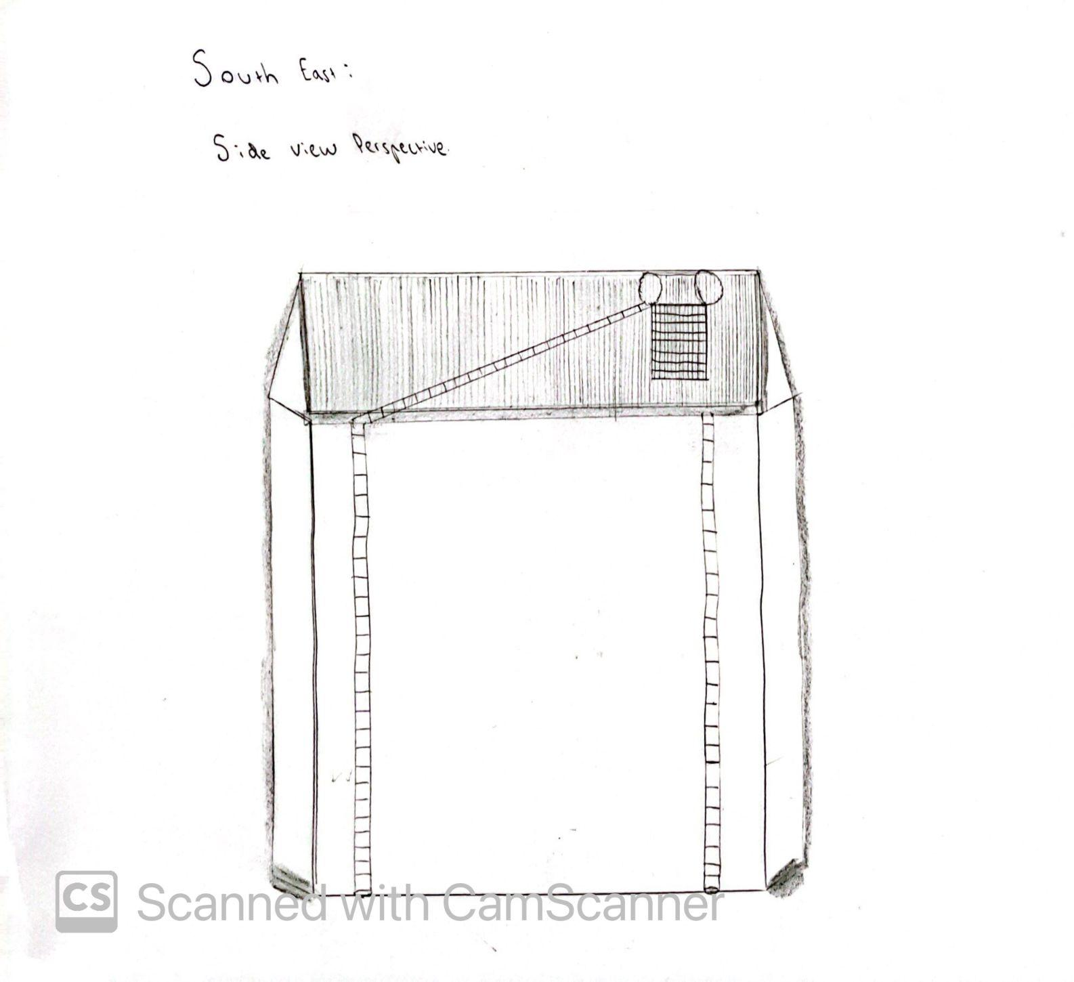
Perspective sketch

Slide 9
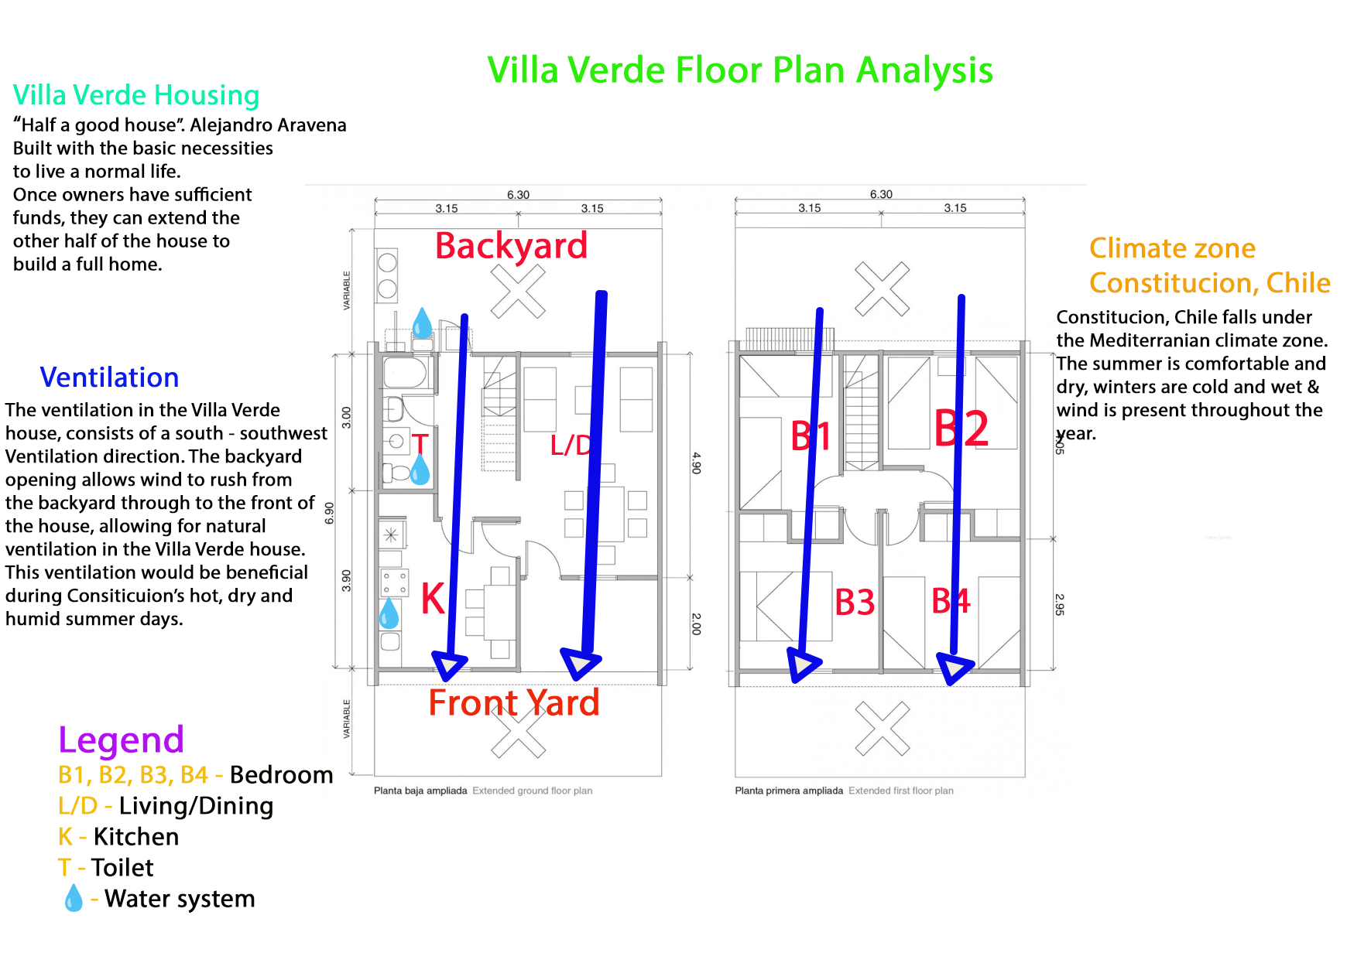

Slide 10
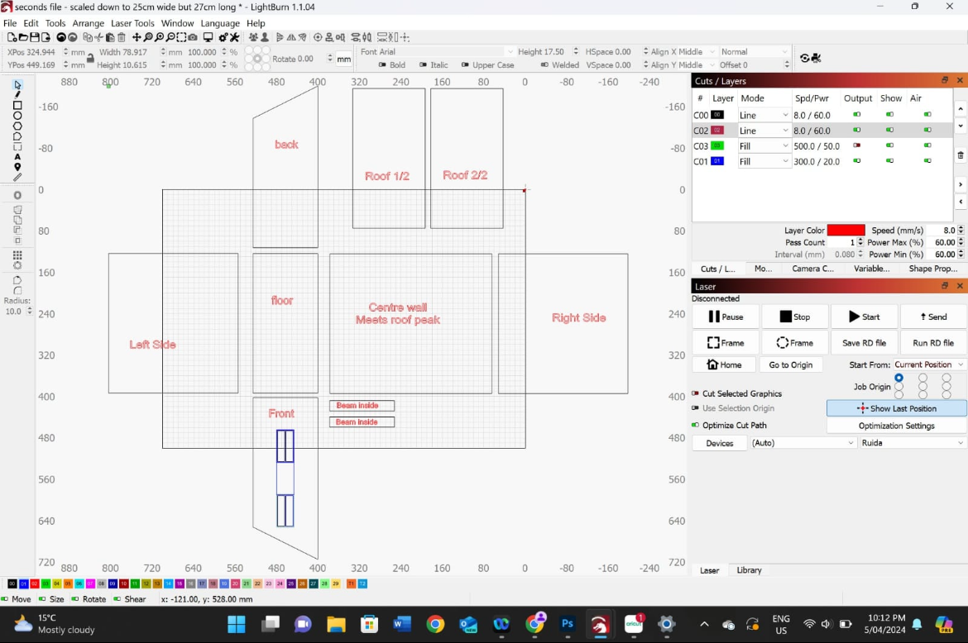
Model Making progress
Each piece we will need to construct the Villa Verde house.
The program the laser uses is called lightburn.

Slide 11
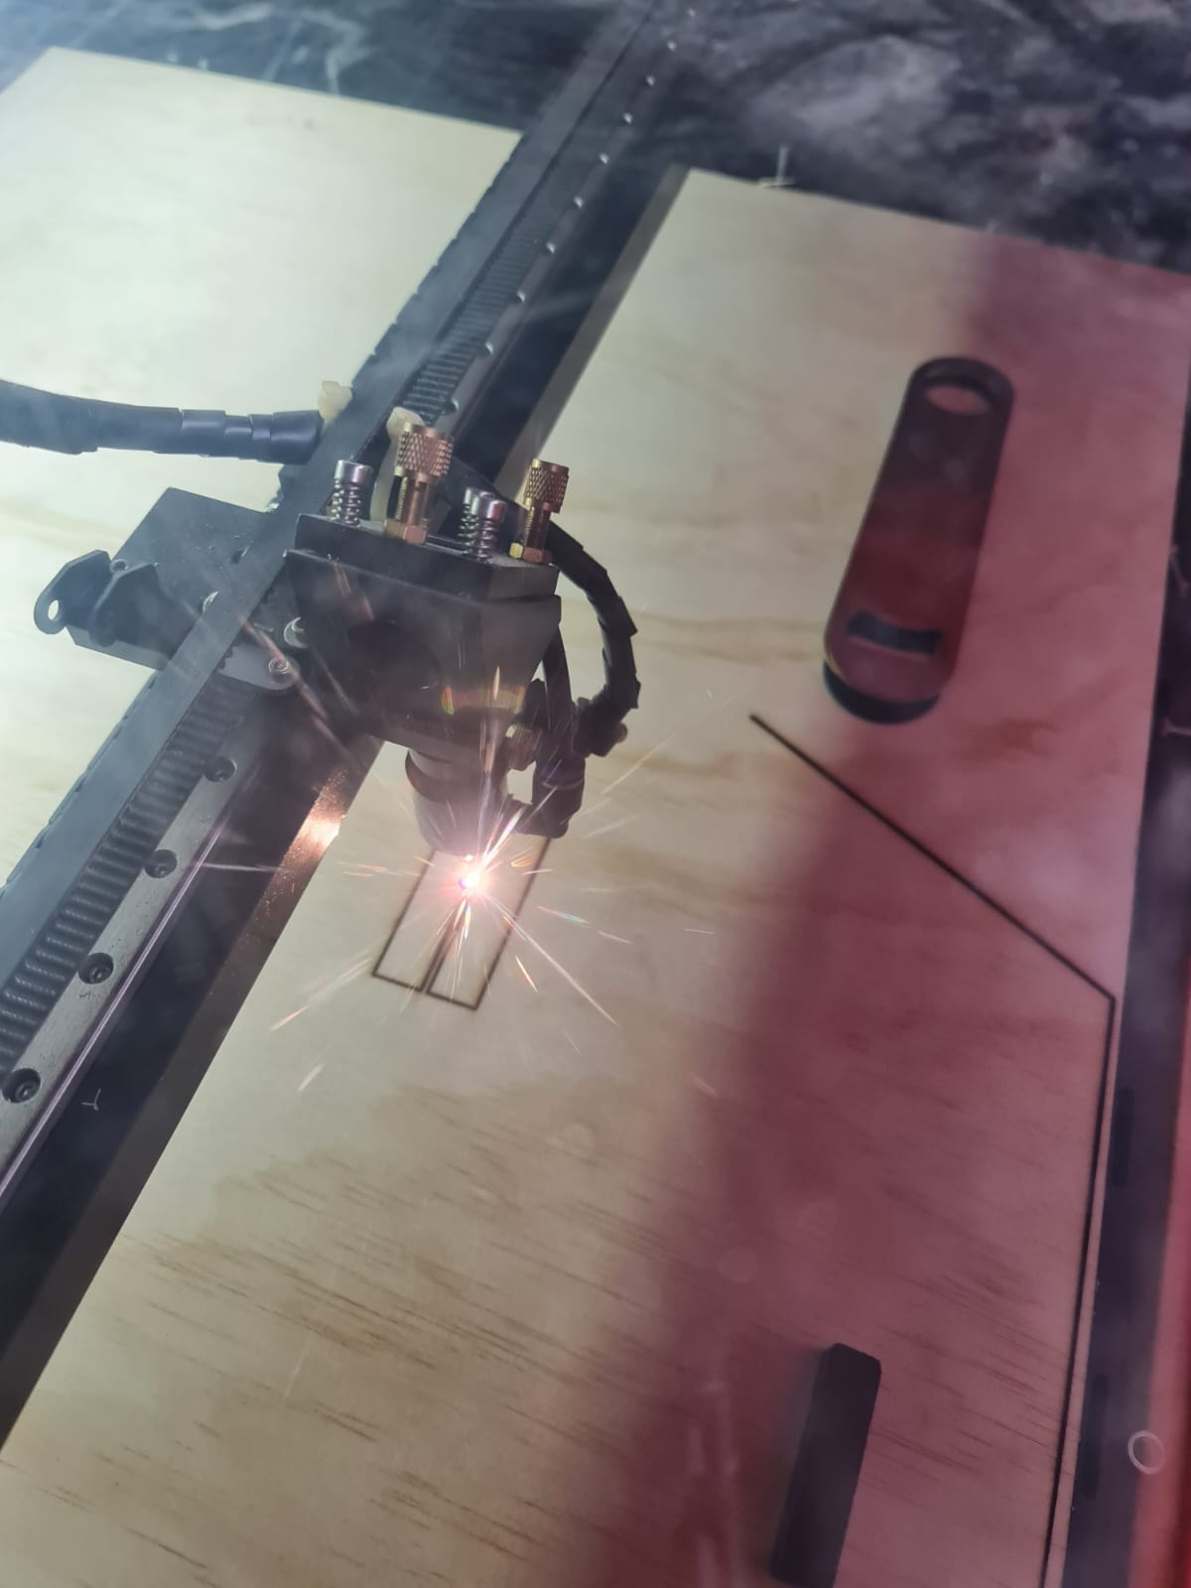
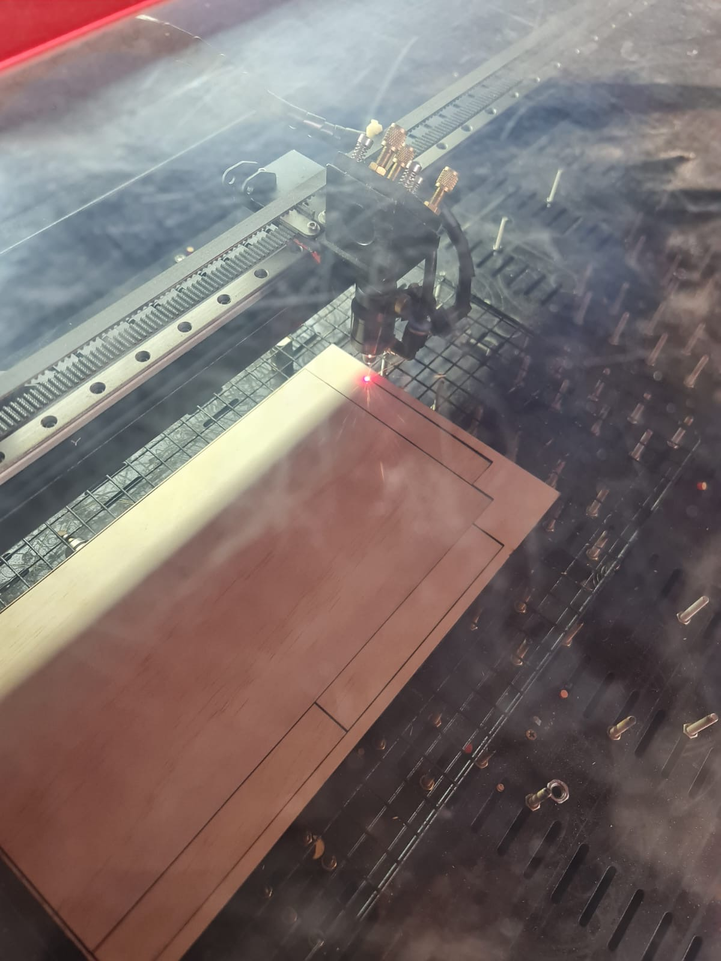
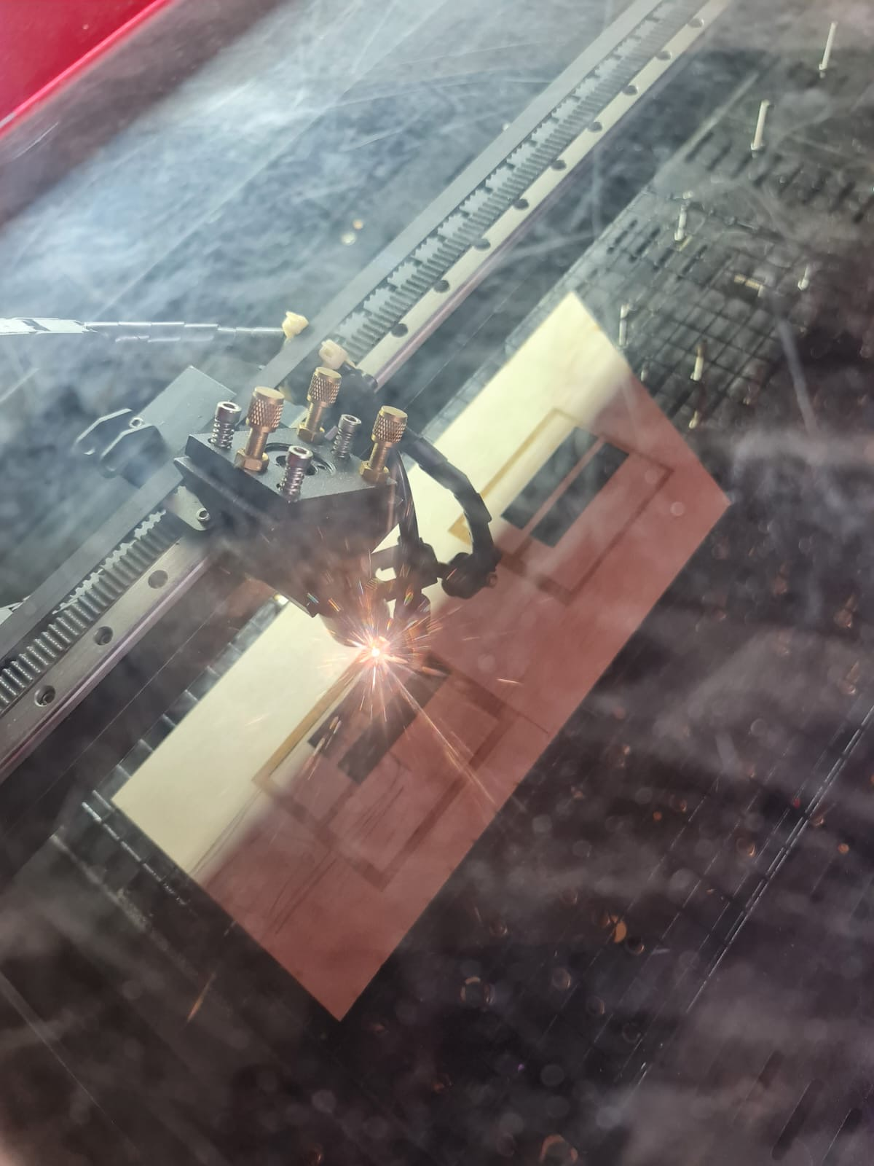
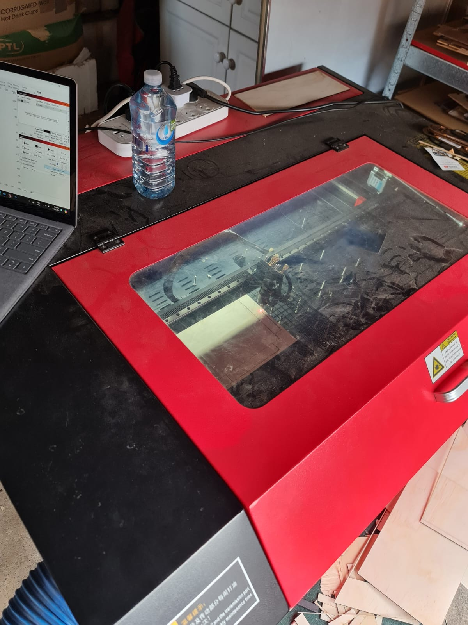
Using laser machine to cut out plywood for house.
60W C02 Laser.
Base is 500m x 700mm - not perfectly level and that is important for the cuts and engravings to work correctly. Cutting smaller pieces at a time, rather than putting everything on at once on one big sheet.

Slide 12
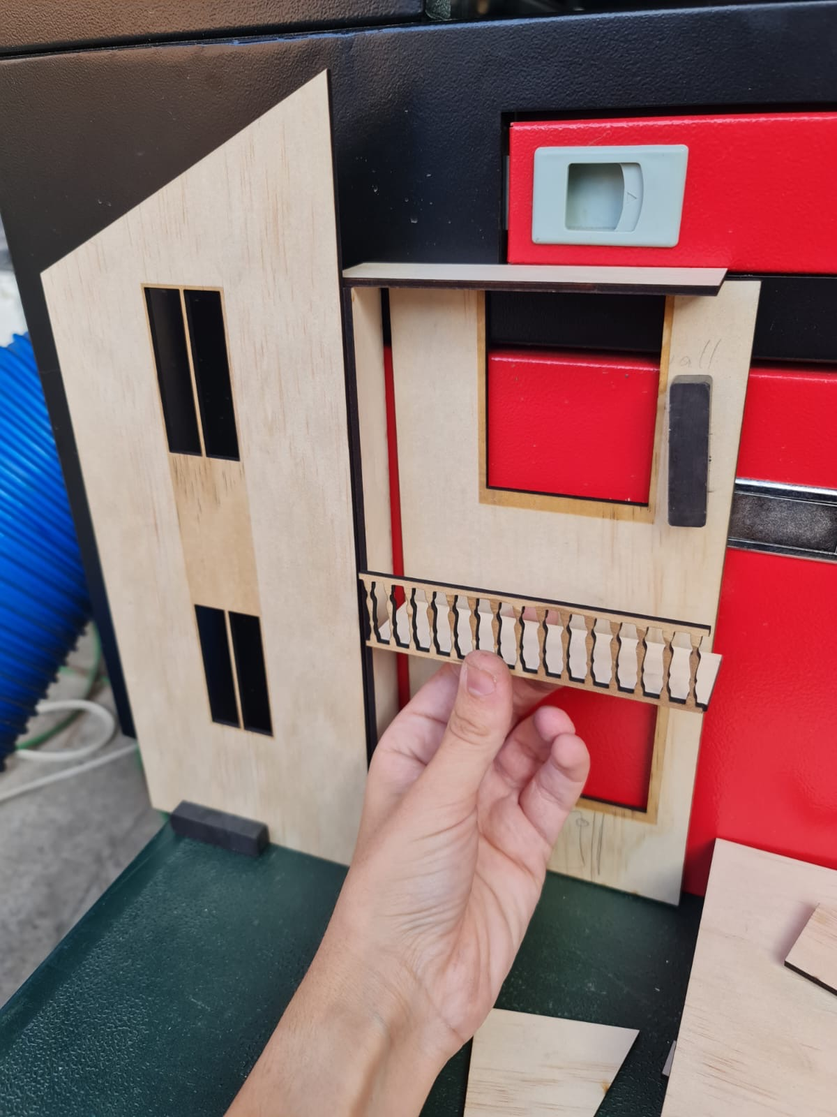
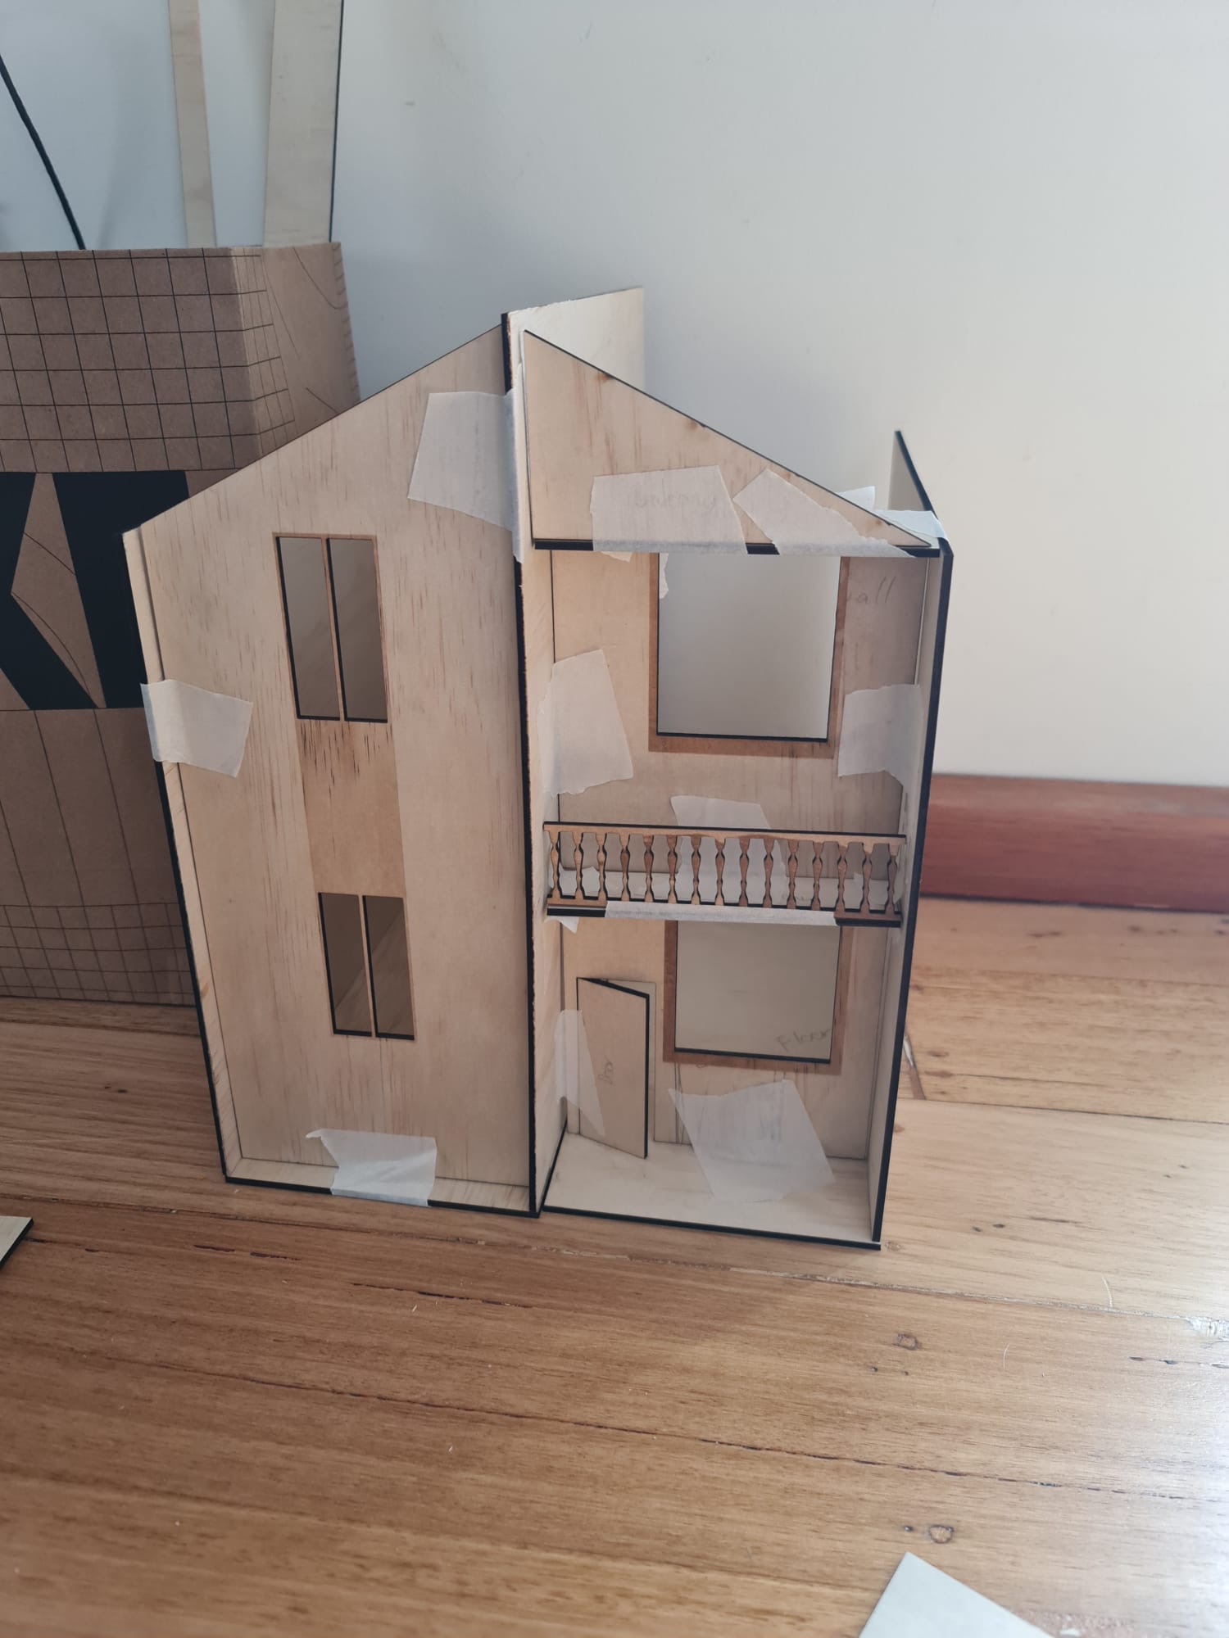
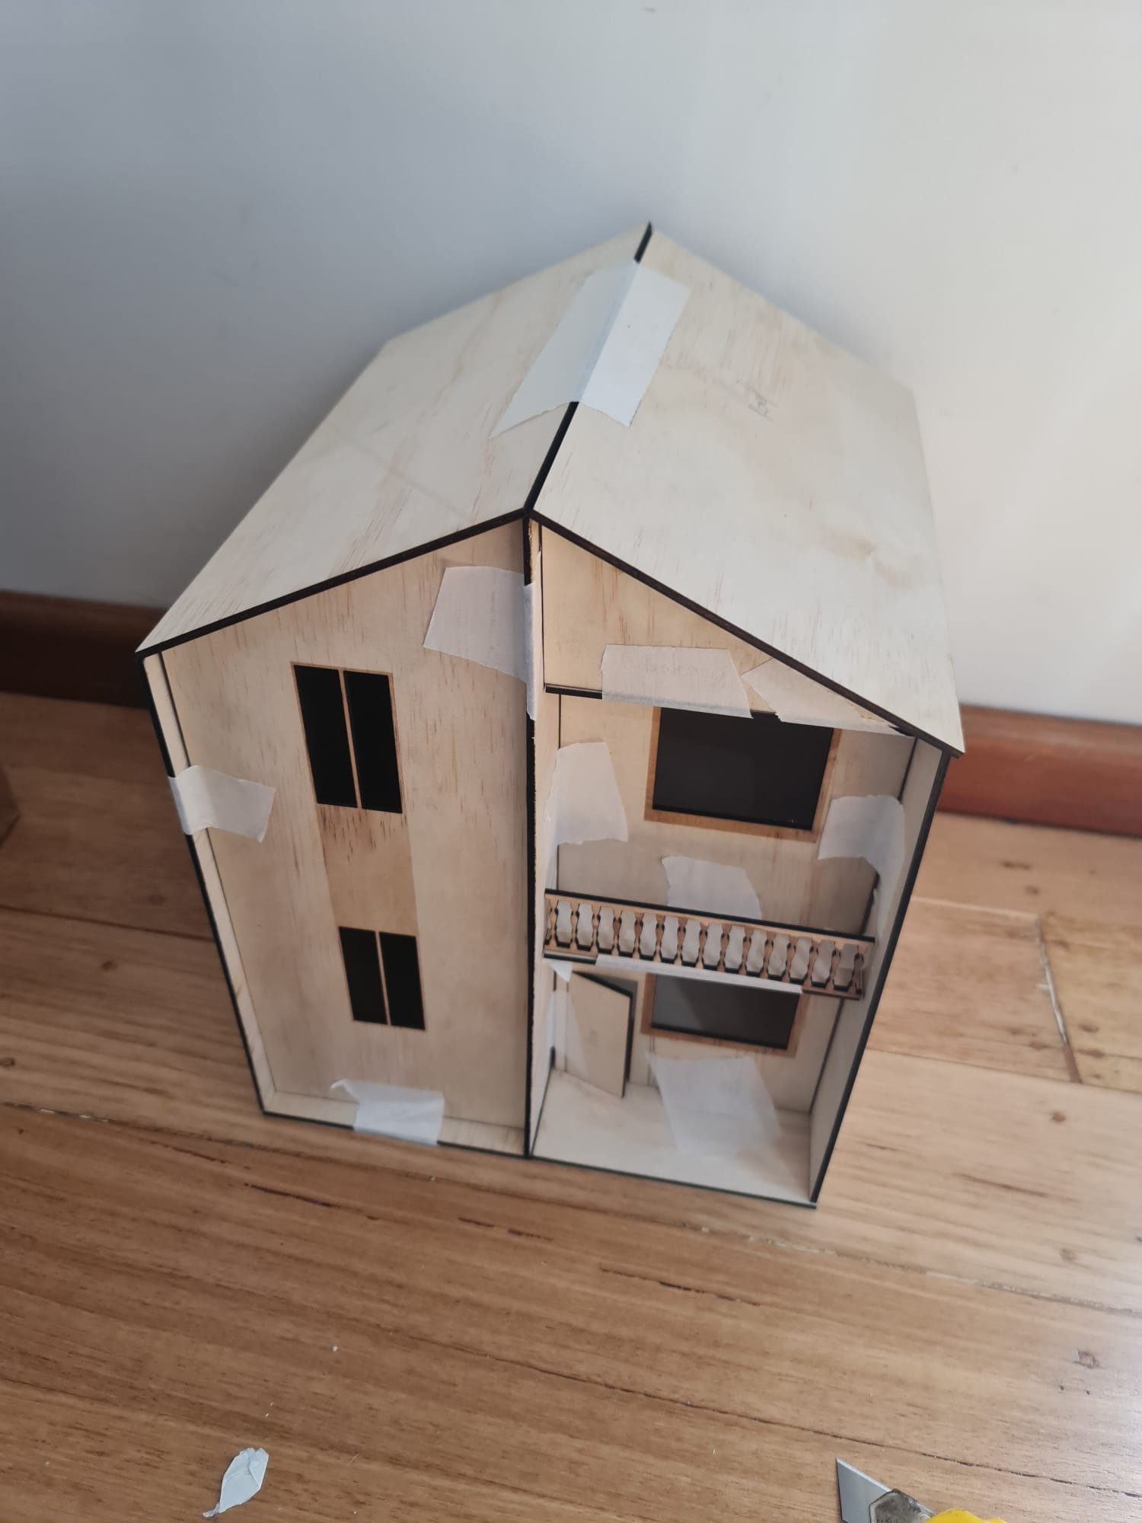
Putting pieces of the house together to ensure each piece fits perfectly and there are no flaws.

Slide 13
Group theme and case study
Our group 3, Karam, Nathan and myself have chosen the theme of cost efficiency within our selected case studies, as it is an important consideration for architects to keep in mind when designing a project. My chosen Architect, Alejandro Aravena designed the project of the Villa Verde housing units. Alejandro designed these houses to be social houses, that were constructed after the destructive earthquake that left devastating effects on the local community of Constitution. The Villa Verde houses were designed this way to accommodate a large number of families in the area and provide them with cheap and sustainable housing that is budget friendly with everything they need to live a normal everyday life. They houses were built in half which came at a cheaper price and once the residents had enough money they could extend to make the full house and customise it in any which way they wanted to. There was a lot of leeway with how the residents could customise their own house. It was too expensive to build a full good house so Alejandro thought why not build half a good house. They housing community was designed to fit many locals, many who were affected from the earthquake.
During the designing of my analysis diagram, I learnt how to use the app, photoshop. It was a rough start which took me a couple days to get used to, even know I am still not the best at it, but I believe I have improved from my first analysis diagram. I have learnt about the sun path of Constitution, the wind patterns, side details, location, ventilation and many more interesting facts about the Villa Verde house. Analysing the floor plans helped me to better understand how the locals are living and what appliances/living space they are in.

